Slide 1


Computer Network & Technology
Member :
Arjun Vankani - 180210107060
Sunil Balas - 180210107002
Kaushal Jani – 180210107016
Guide : Chinmay sir Vyas
Branch : Computer Science

Slide 2

Python Nmap Module
Network Mapper or Nmap is a module in python which is used to create an open port scanner. It is better known as a foot-printing or reconnaissance tool. Reconnaissance in ethical hacking terms means finding information about the target. The target can be in the form of a website or IP address.
Information can be the name of the operating system used or characteristics of the network devices. But the primary use of Nmap is to design an open port scanner. An open port scanner is used to scan what all ports are open and what all ports are closed.

Slide 3
What is Nmap in python?
In technical terms, nmap is a tool that is used for security auditing and network discovery. The way nmap works is by sending raw IP packets to determine if the target host is available on the network, what services the target host is providing, what type of firewalls are in use, what operating system versions are running, and tons of other characteristics.
Syntax : To use the nmap module in python, we first need to install the online tool. After installing it, we need to install the nmap module using pip install python-nmap.
Note that we cannot target any website or IP address as that is illegal so that we will use the localhost i.e., 127.0.0.1

Slide 4
SYN-ACK Scanning using Nmap
When we want to know about the state of the port without establishing the full connection, we perform SYN scanning. This is possible by sending synchronous packets to every port of the target host (for three-way handshaking). If the target host server responds with SYN/ACK (synchronization acknowledged), it means that the port is open.

Slide 5
What is ICMP? (Internet Control Message Protocol)
The Internet Control Message Protocol (ICMP) is a supporting protocol in the Internet protocol suite. It is used by network devices, including routers, to send error messages and operational information indicating success or failure when communicating with another IP address, for example, an error is indicated when a requested service is not available or that a host or router could not be reached. ICMP differs from transport protocols such as TCP(Transmission Control Protocol) and UDP(User Datagram Protocol) in that it is not typically used to exchange data between systems, nor is it regularly employed by end-user network applications (with the exception of some diagnostic tools like ping and traceroute).

Slide 6
UDP Scan
User Datagram Packet is a connectionless protocol for video streaming or audio streaming purposes. It is fast but unreliable. We perform a UDP Scan when we want to search for UDP ports that are open or vulnerable. The process to know about the state is mostly the same as above. There are four types of state based on the responses.
If we get a response, then the state is ‘OPEN.’
Response is not there , then the state is ‘OPEN|FILTER’
For ‘ICMP port unreachable error (type 3, code 3)’, then the state is ‘closed.’
And if we get ‘Other ICMP unreachable errors (type 3, code 1, 2, 9, 10, or 13)’, it means the state is ‘FILTERED.’

Slide 7
COMPREHENSIVE SCAN
This scan does a lot of hard work in information gathering. Even if the handshake is not possible in the first attempt, it will keep trying, and if it gets success, it will try to know about the Operating System Version and other relevant information.
Regular Scan & Ping Scan
A regular scan tries to find 1000 most common scans and uses the ICMP Echo request for host detection.
Pinging means scanning if a host is active on the network or not.

Slide 8
Multiple IP Range
OS DETECTION
Using nmap we can detect what OS does the target work on, and service detection for devices. It is possible by using the TCP/IP stack fingerprinting method.
It is quite common that we will want to check the services of multiple hosts, so in nmap we have an option to give a range of ip addresses for scanning.

Slide 9
Alternatives of Nmap
Wireless Network Watcher -> Free
SoftPerfect Network Scanner -> Commercial(PAID)
Advanced Port Scanner -> Free
Port Authority -> Free
Advanced IP Scanner -> Free
Zen map -> Free + OPEN SOURCE

Slide 10
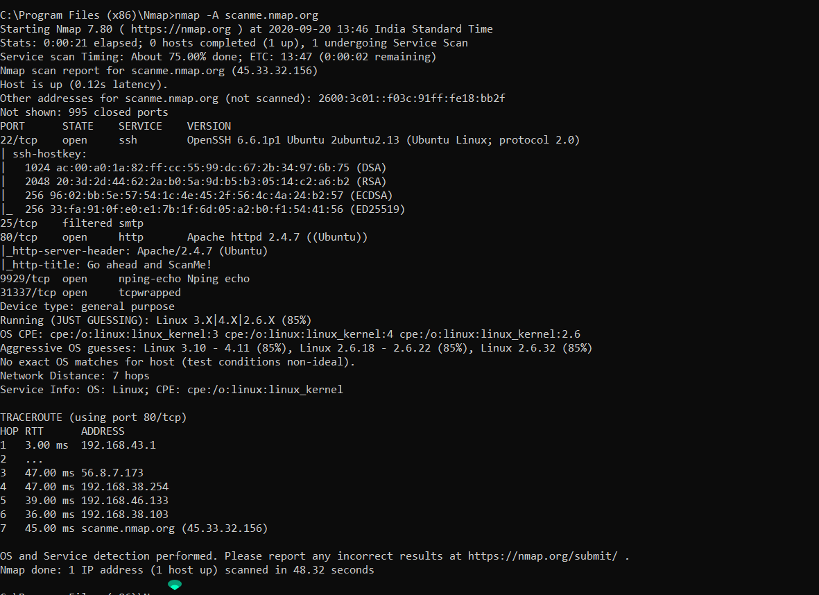

N-Map (network Mapper)
Nmap (Network Mapper) is a free and open-source network scanner.
Nmap is used to discover hosts and services on a computer network by sending packets and analyzing the responses.
Nmap provides a number of features for probing computer networks, including host discovery and service and operating system detection. These features are extensible by scripts that provide more advanced service detection, vulnerability detection, and other features. Nmap can adapt to network conditions including latency and congestion during a scan.
You may referee from https://en.wikipedia.org/wiki/Nmap also.
Download link : https://nmap.org/
Command : > nmap -A scanme.nmap.org

Slide 11

(Nmap) Zen-map in GUI
Software based
Port scanning
Operating system fingerprinting

Slide 12


Application
Here are some things Nmap can do:
Find computers on a network.
Find the open ports from the computer network.
Find the protocols of those ports.
We can also find the Operating system if the target system.
We can explore many scanning techniques like port scanning, ping scanning, Os scanning, Regular scan, intense scan, UDP scan, Aggressive scan.

Slide 13
Flag | Use | Example
-T0 | Paranoid IDS evasion | nmap -T0 104.244.42.5
-T1 | Sneaky IDS evasion | nmap -T1 104.244.42.5
-T2 | Polite IDS evasion | nmap -T2 104.244.42.5
-T3 | normal speed scan | nmap -T3 104.244.42.5
-T4 | aggressive speed scan | nmap -T4 104.244.42.5
-T5 | Insane speed scan | nmap -T5 104.244.42.5
Timing and Performance
Flag | Use | Example
-f | Use fragmented IP packets | nmap -f 104.244.42.5
-D | Decoy scans | nmap -D 104.244.42.5
-g | Use a given source port number | nmap -g 104.244.42.5
IDS Evasion
Flag | Use | Example
-sC | Default script scan | nmap -sC 104.244.42.5
-script banner | Banner grabbing | nmap -script banner 104.244.42.5
NSE Scripts

Slide 14
Flag | Use | Example
-sS | TCP syn port scan | nmap -sS 104.244.42.5
-sT | TCP connect port scan | nmap -sT 104.244.42.5
-sU | UDP port scan | nmap -sU 104.244.42.5
-sA | TCP ack port scan | nmap -sA 104.244.42.5
Scanning techniques
Flag | Use | Example
-Pn | Only port scan | nmap -Pn 104.244.42.5
-sn | Only host discovery | nmap -sn 104.244.42.5
-PR | ARP discovery | nmap -PR 104.244.42.5
-n | Disable DNS resolution | nmap -n 104.244.42.5
Host discovery
Flag | Use | Example
-p | Specify a port or port range | nmap -p 1-30 104.244.42.5
-p- | Scan all ports | nmap -p- 104.244.42.5
-F | Fast port scan | nmap -F 104.244.42.5
Port specification
Flag | Use | Example
-sV | Detect the version of service running | nmap -sV 104.244.42.5
-A | Aggressive scan | nmap -A 104.244.42.5
-O | Detect operating sysyem of the target | nmap -O 104.244.42.5
Service version and OS detection

Slide 15
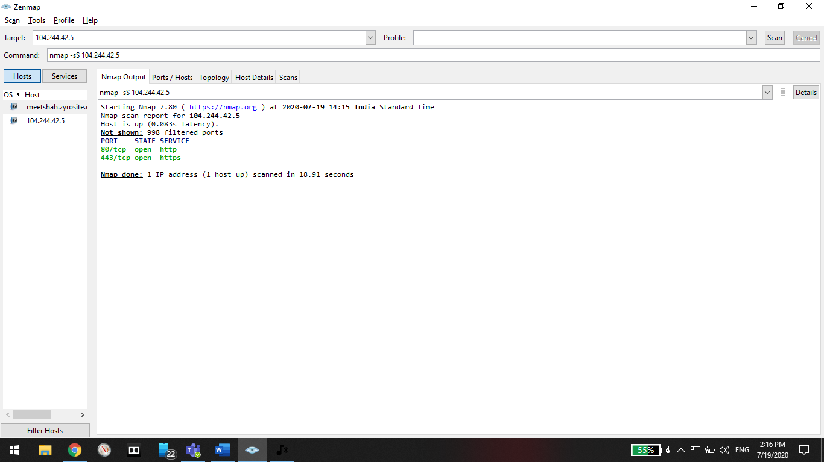
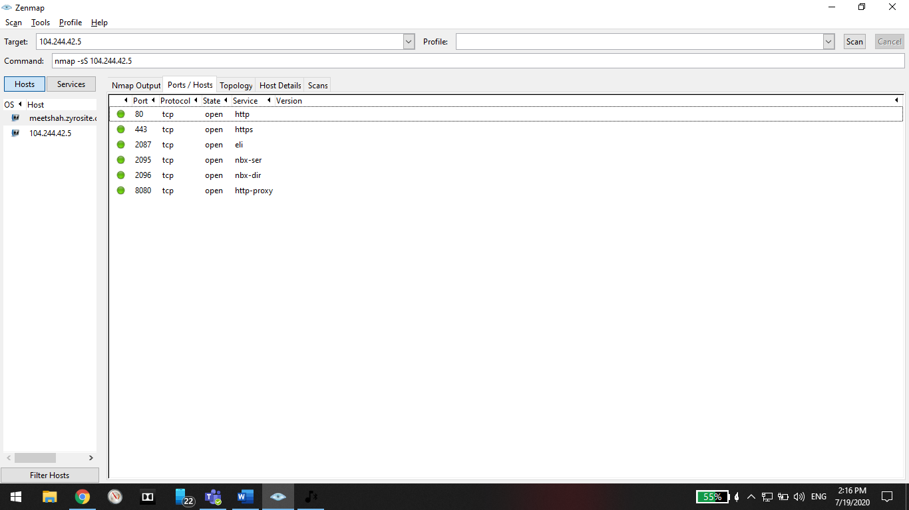
Scanning

Slide 16

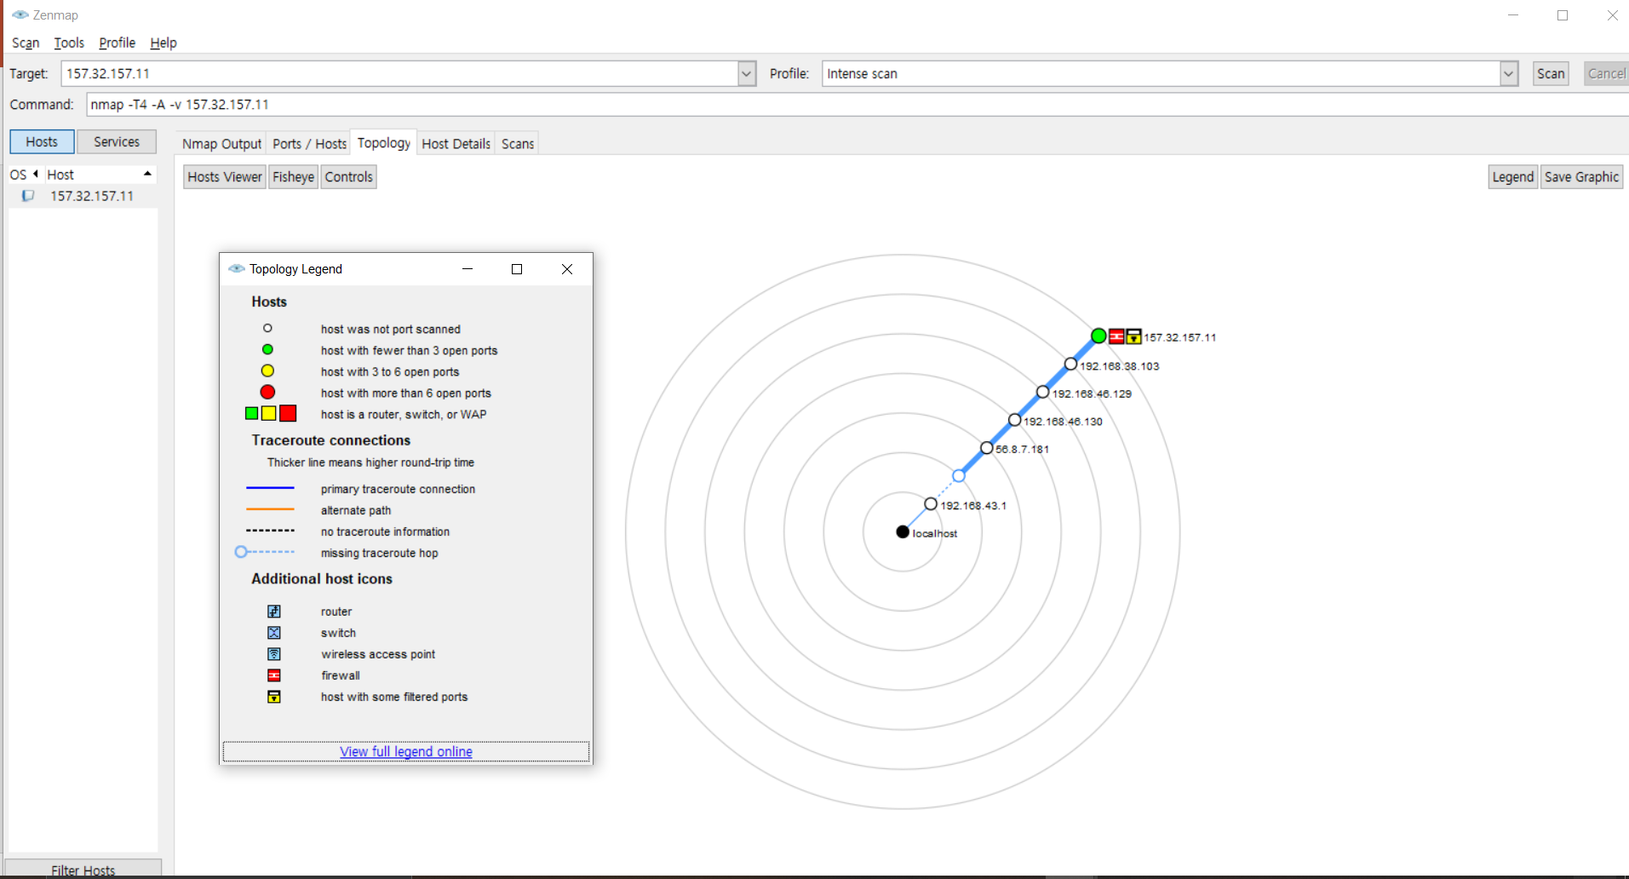
Topology & Host details

Slide 17

Make Connection using NCAt tool
Command Prompt based
(server & client)
Also Data transfer

Slide 18
What is Net Cat ?
NetCat is a computer networking utility from and writing to network connections using TCP or UDP. The command is designed to be a dependable back-end that can be used directly or easily driven by other programs and scripts.
NetCat is preinstall in “Kali Linux” and in windows with the help of “Nmap” software we can also explore Netcat.
With the help of “ncat” command we can use “Netcat” features.
Ncat is a general – purpose command -line tool for reading, writing, reading and encrypting the data across the network. It aims to be your network “Swiss Army knife”, handling a wide variety of security testing and administration tasks. Ncat is suitable for interactive use or as a network-connected back end for other tools.

Slide 19
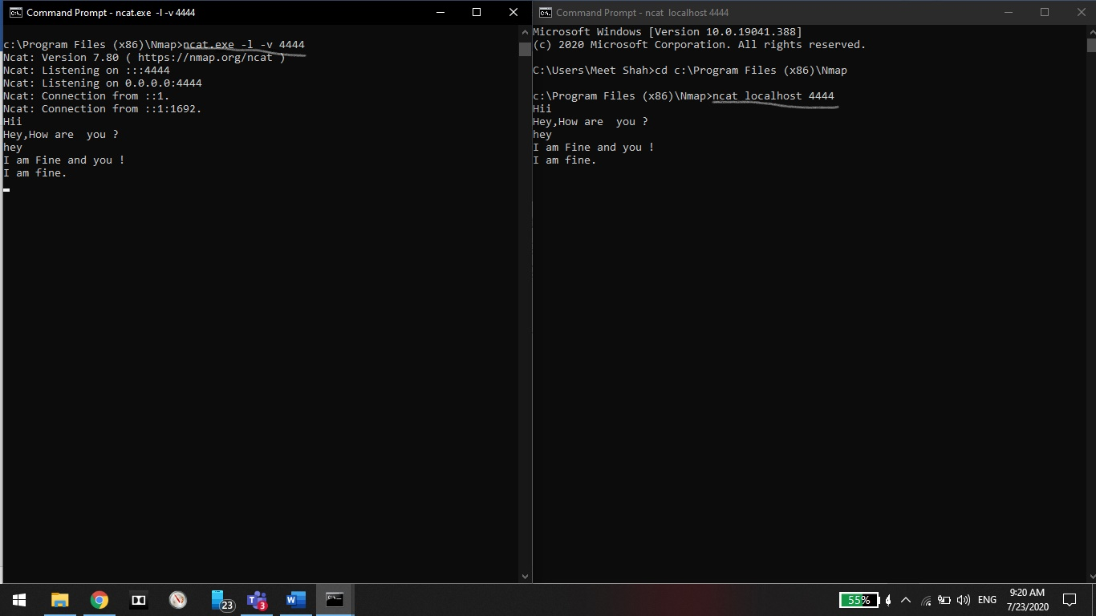
Local host

Slide 20
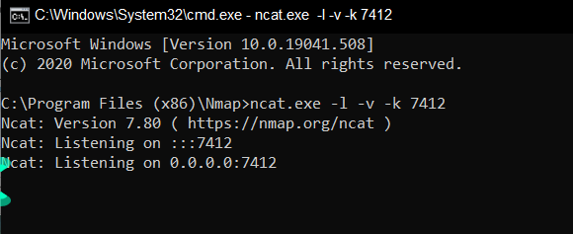
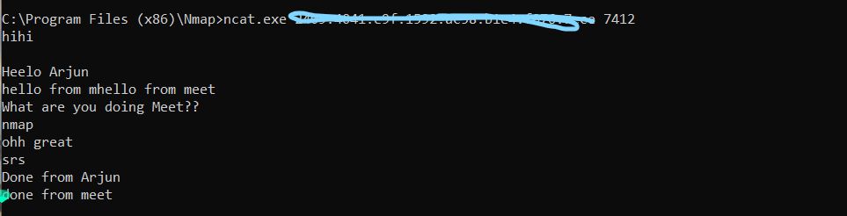
Server Client

Slide 21
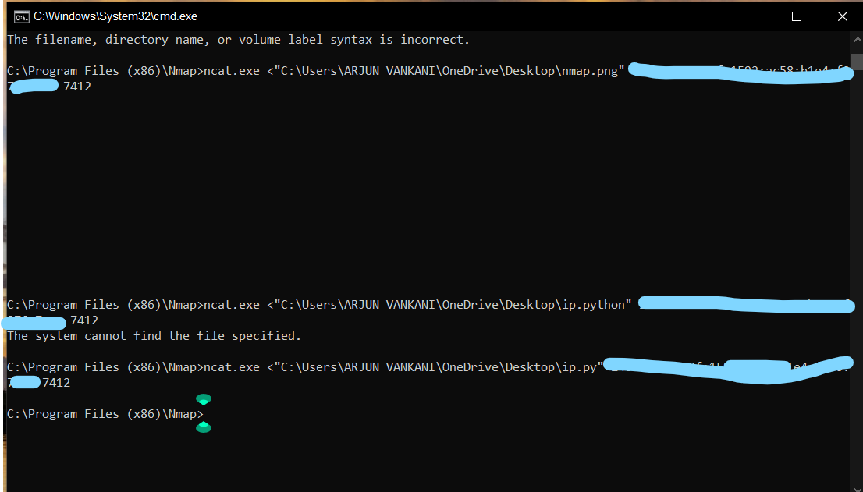
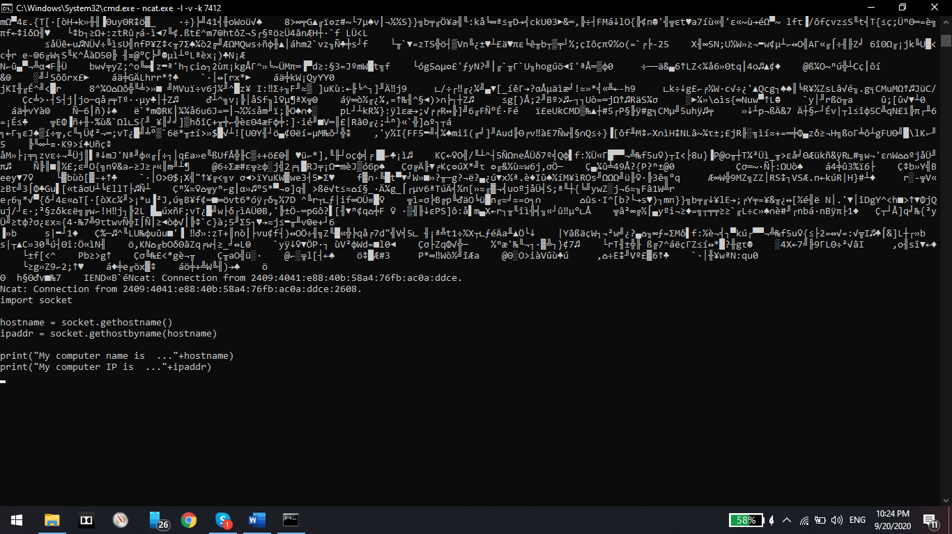
Data transfer

Slide 22
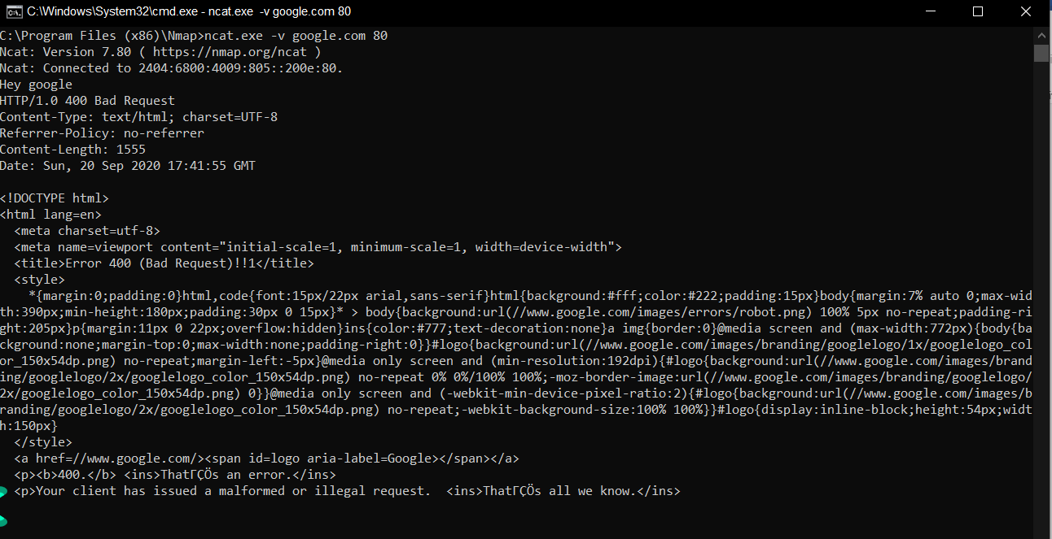
Communication

Slide 23
Scapy With Python

Slide 24

What is Scapy ?
Scapy is a Python program that enables the user to send, sniff and dissect and forge network packets. This capability allows construction of tools that can probe, scan or attack networks.
Scapy is a powerful interactive packet manipulation program. It is able to forge or decode packets of a wide number of protocols, send them on the wire, capture them, match requests and replies, and much more.

Slide 25
Why learn Scapy ??
It provides us with a lot more functionalities than any other tool or module. Here are some of its features:
Can craft any packet and encode it
Sniffing network packets
Sending valid/invalid frames
Injecting your own 802.11 frames
Editing network packets on the fly
Scanning the network
Tracerouting and probing
Attacking networks
Network discovery

Slide 26
Sending & Receiving packets
For sending and receiving packets,
SR() : This function is for sending packets and returns the answers to those sent packets
SR1() : Similar to the SR() function, this function returns only one packet that answered the sent packet(or set of packets)

Slide 27
Low level operations
Sending or receiving packets (send(), sendp(), sniff())
Reading/writing pcap capture files (rdpcap(), wrpcap())
Sending packets, receiving answers and matching couples (sr(), sr1(), srp(), srp1())
Self documentation (ls(), lsc())

Slide 28
Reading & Writing PCAPS
Reading pcap files,
packets = rdpcap(“directory.pcap”)
packets.summary()
Writing pcap files,
packets = sniff(iface=“eth0”,filter=“tcp and port 80”,count=10)
wrpcap(“/tmp/write.pcap”, packets)
Wireshark Integration,
wireshark(packets)

Slide 29
High level operations
Quick TCP traceroute (traceroute())
Passive OS fingerprinting (p0f())
Nmap OS fingerprinting (nmap_fp())
TCP – Scanning
DNS
ARP-Ping
TRACEROUTE
Sniffing

Slide 30


THANK YOU SO much
FIRST UP CONSULTANTS

